Slide 1


Audio Emotion Classifier
Presented by Janelle Tam,
Yun Jia Zhuang, and Sina Salmannia

Slide 2
Our model and Dataprocessing

Slide 3

Resampling, Normalization, Padding
Resampling
Normalization
Angry
Angry - Resampled
Padding

Slide 4
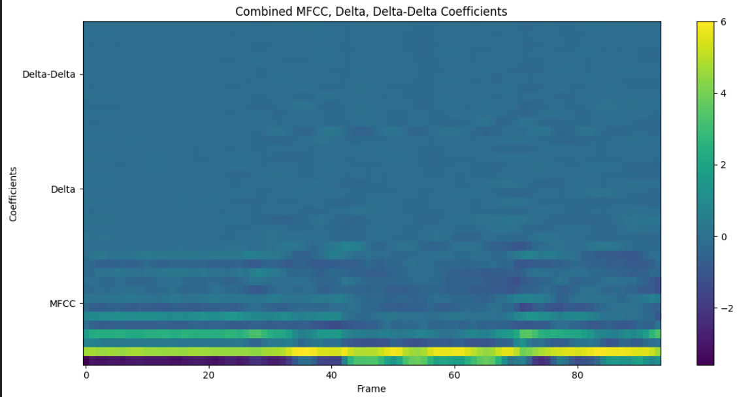
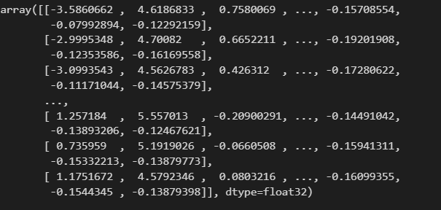
MFCCs

Slide 5
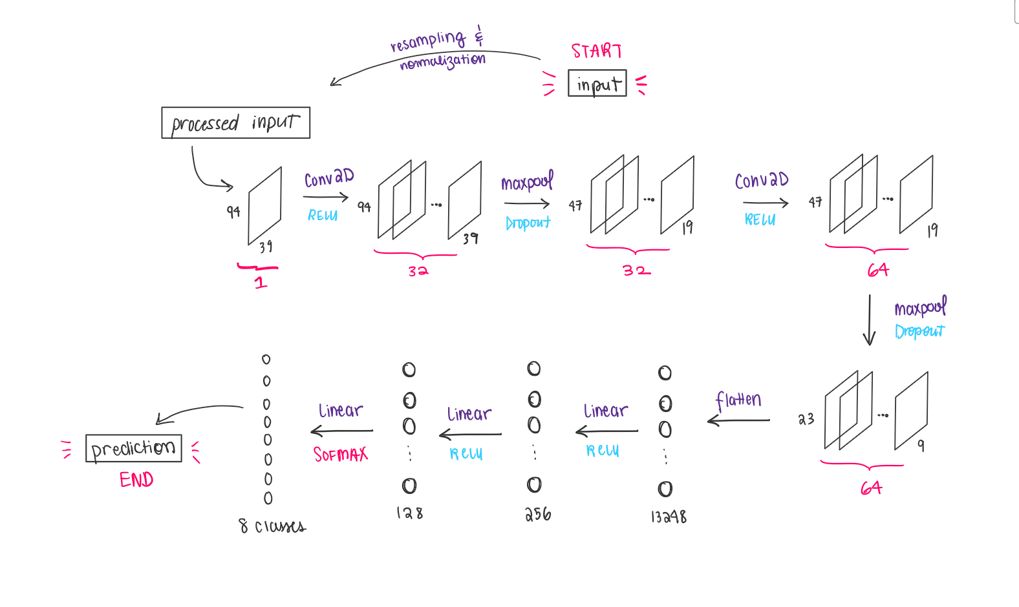
CNN Layers

Slide 6
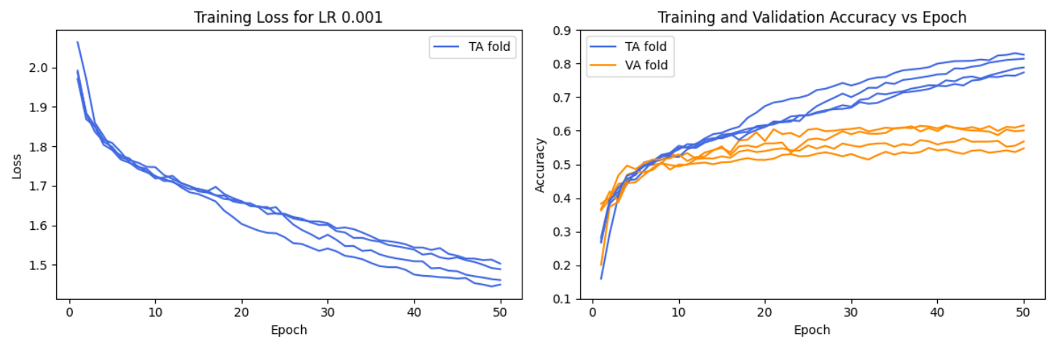
Grid Search / Bayesian Optimization / K-fold Cross-Validation

Slide 7
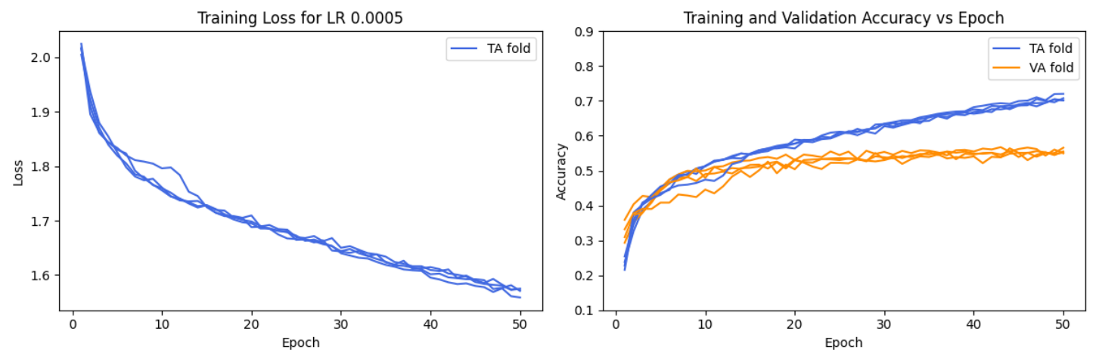
Grid Search / Bayesian Optimization / K-fold Cross-Validation

Slide 8
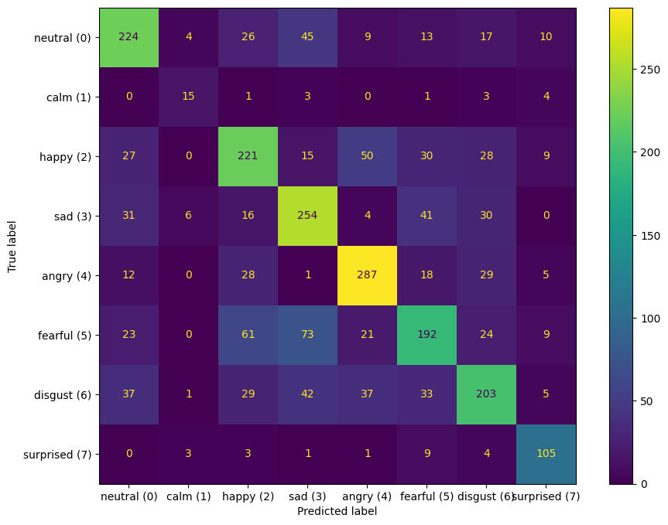
Results
Test accuracy: 61.69%
Test dataset size: Over 2433 files

Slide 9
Improvements to our model
Improving our model
Augmenting our dataset with four commonly confused emotions: EmoDB (German dataset)
Sad/fearful
Sad/neutral
Happy/fearful
Deleting files labelled ‘calm’ from dataset (not enough samples since only one dataset had that emotion)
Removing silence from audio
Increasing audio length
Something happened…
New model never predicts the ‘surprise’ label…

Slide 10
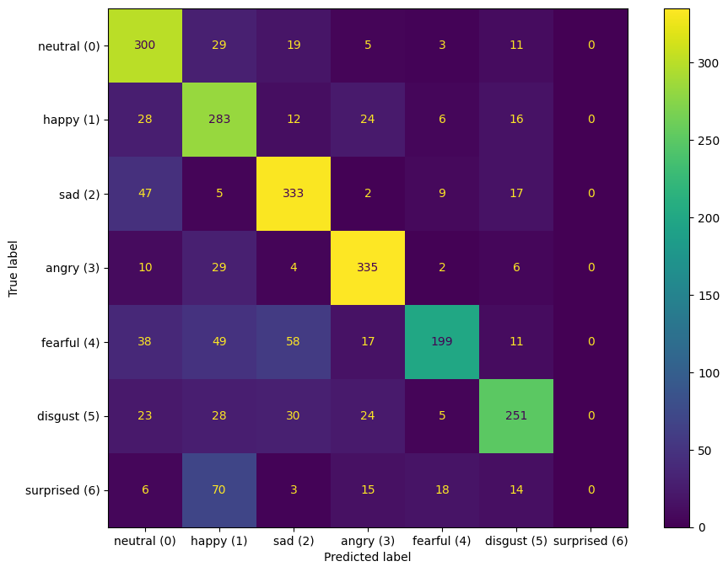
Issues
Confusion matrix over
test dataset

Slide 11
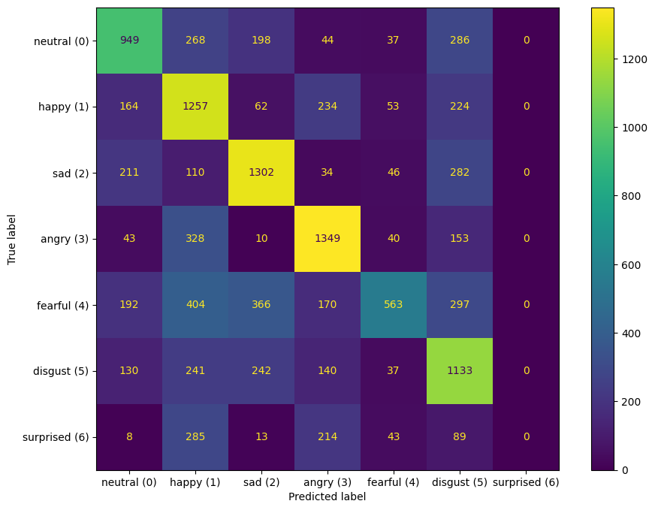
Issues
Confusion matrix over
train dataset

Slide 12
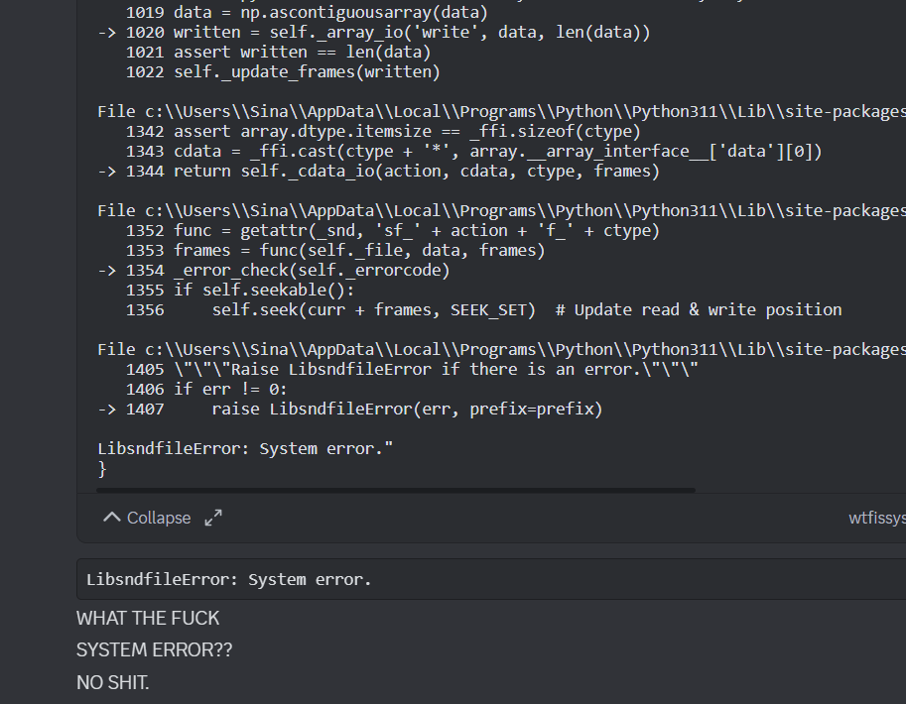
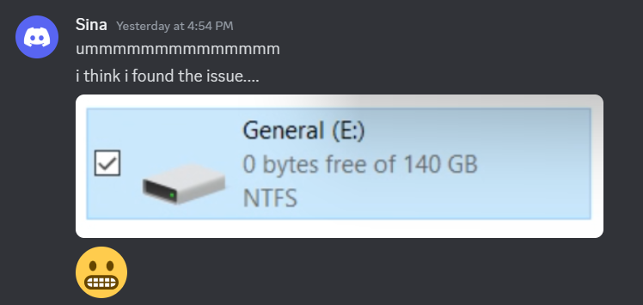

Issues: Model too large

Slide 13
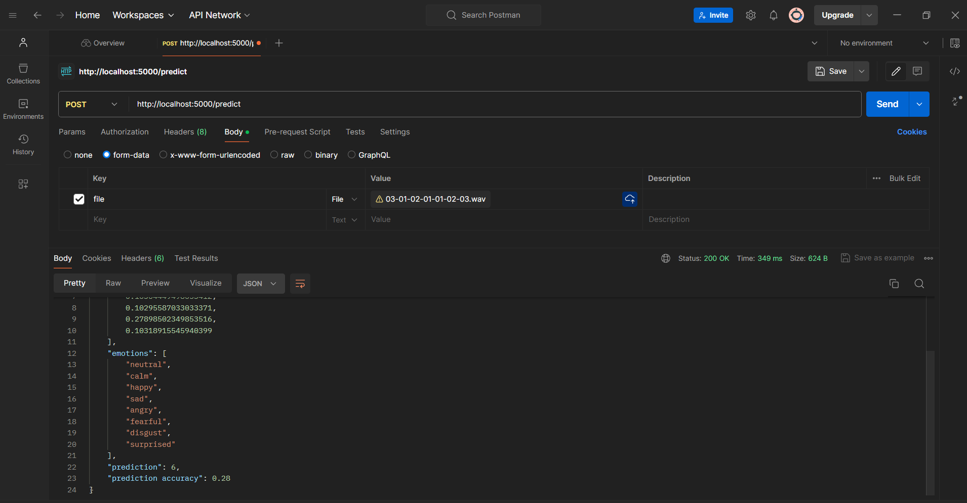
Testing (Flask and React)

Slide 14

Webapp!

Slide 15
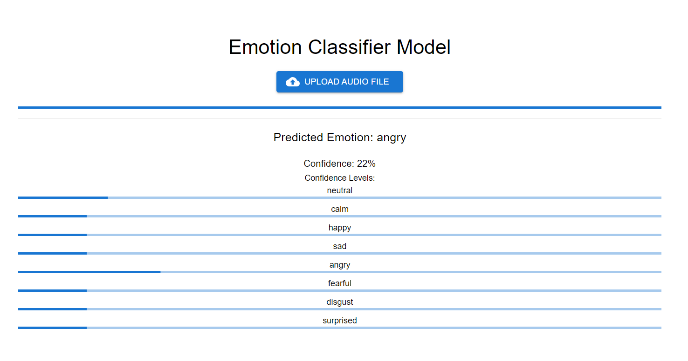
Emotion: Angry

